Slide 1
Tracking nuclei using Keller lab Tgmm software
Afnan Azizi (aa718@cam.ac.uk)
13/12/16

Slide 2
Cell tracking challenges
Various methods of segmentation and tracking
Large variability in biological samples
Distinguishing various types of behaviour (e.g. movement or division)
Handling of large data sets

Slide 3
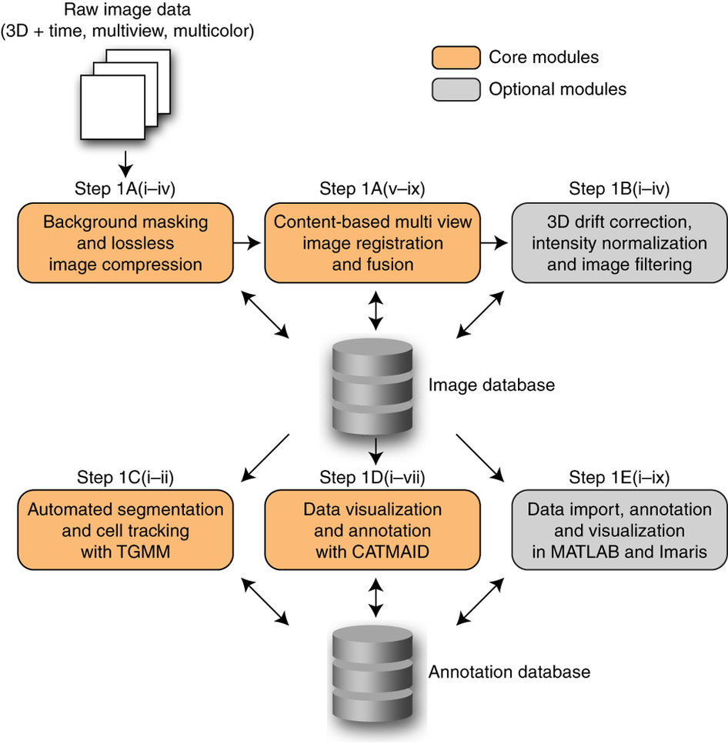
TGMM software workflow
Amat et al. 2015, Nature Protocols

Slide 4
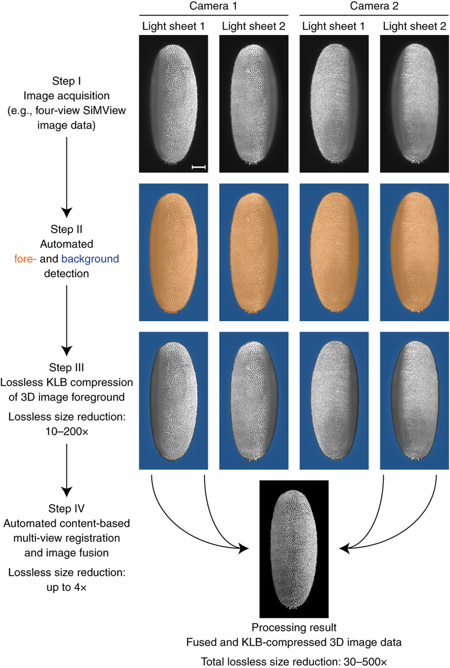
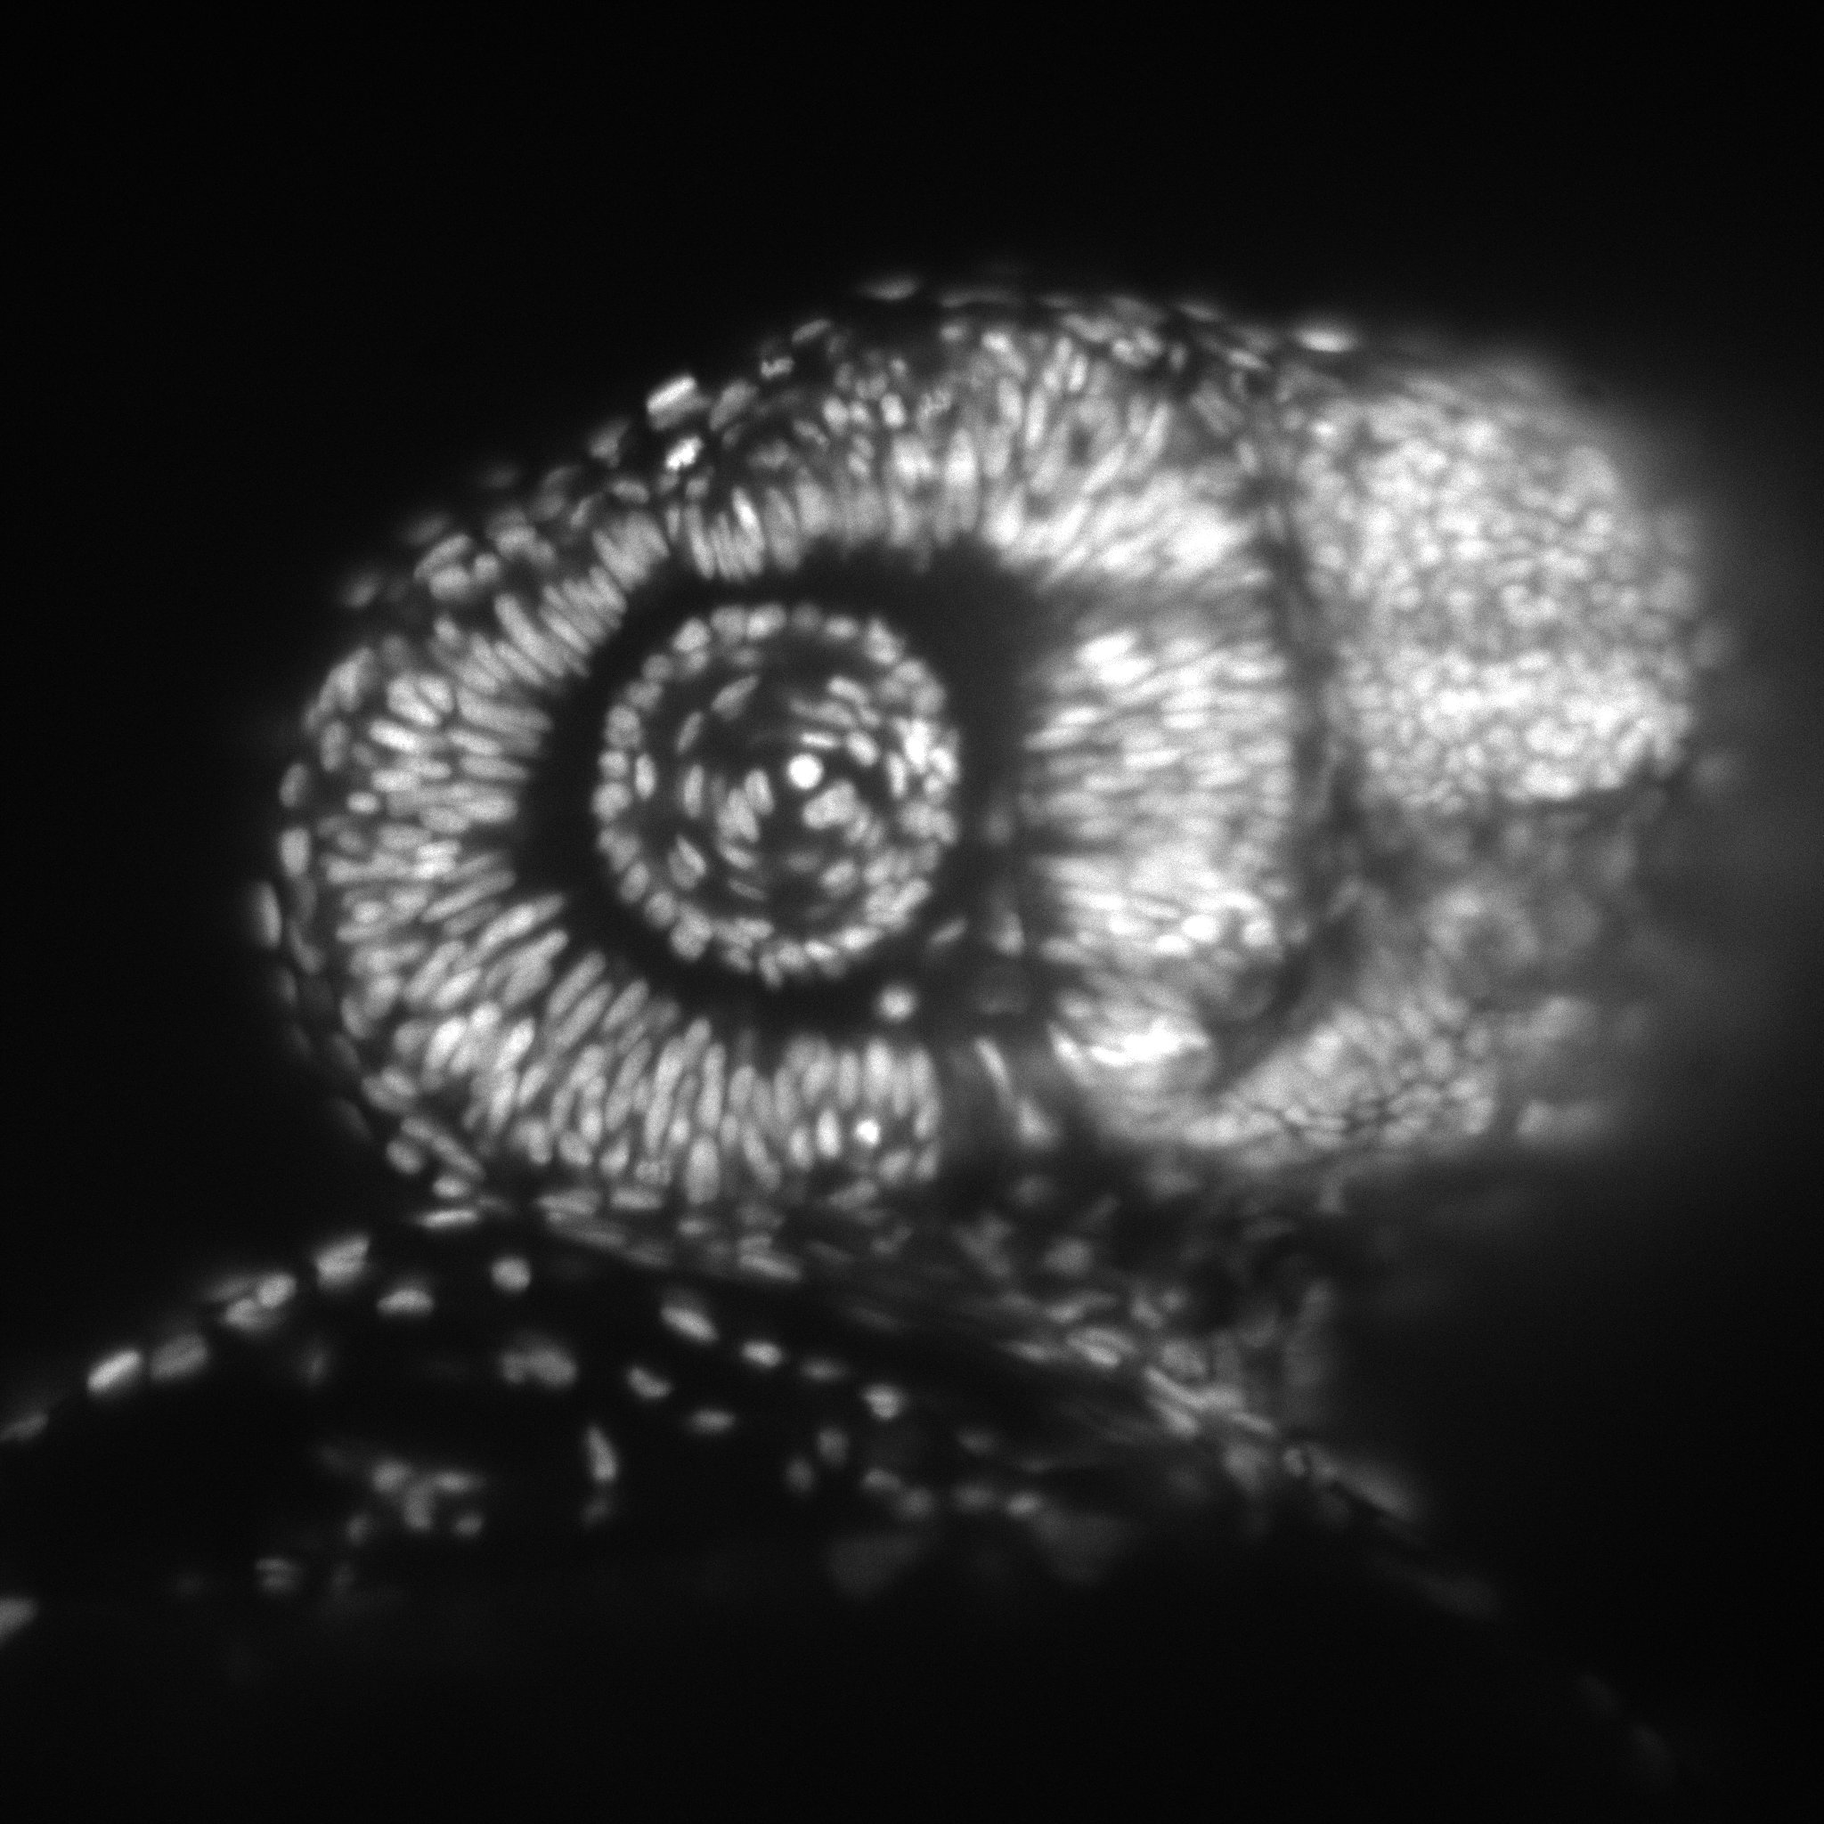
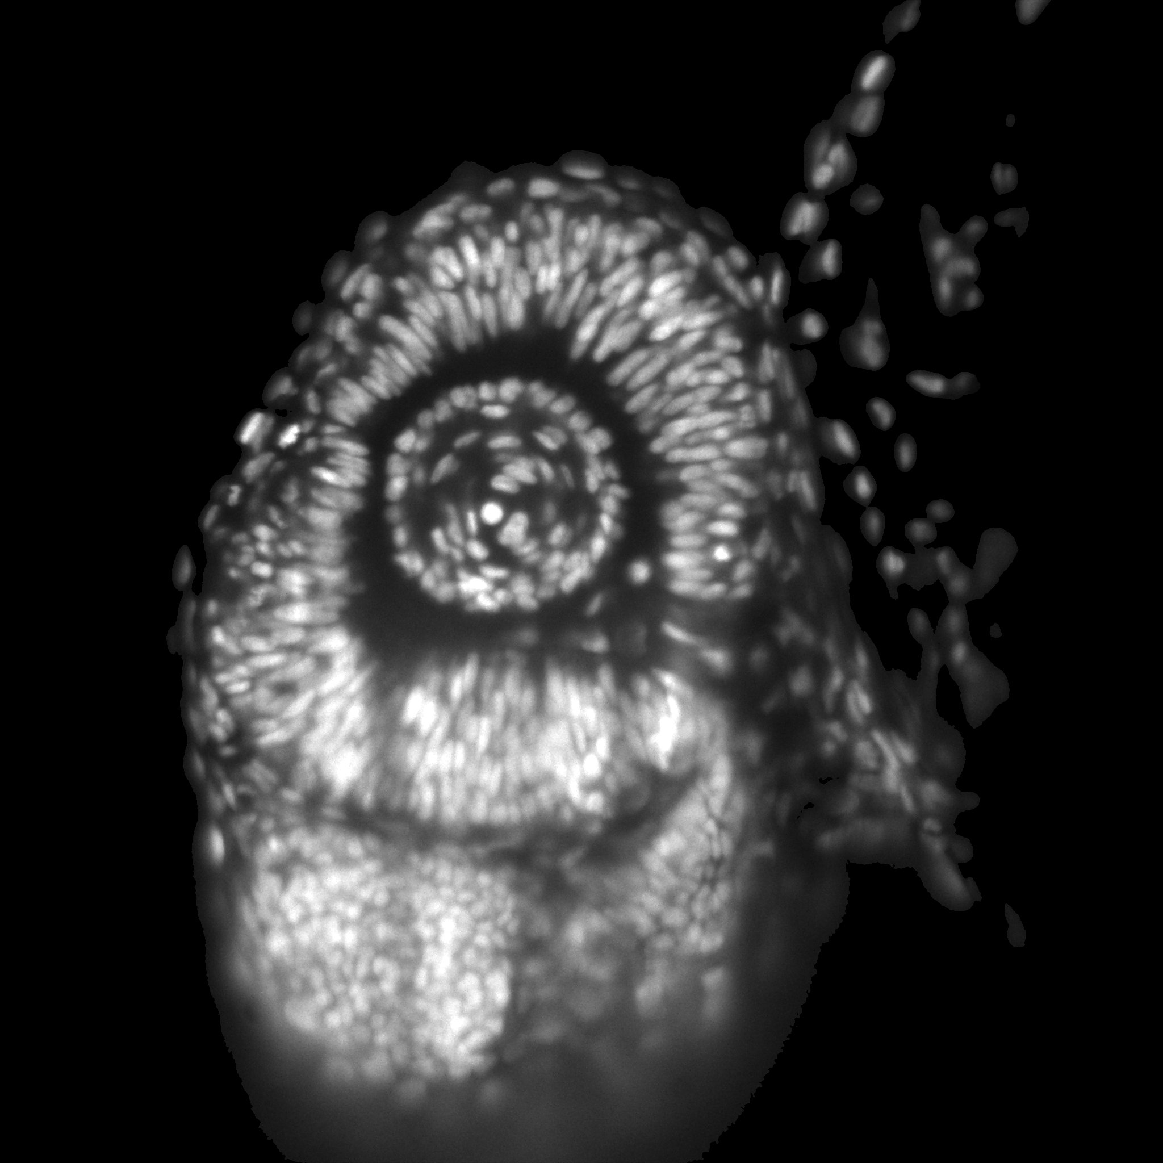
Image compression
MATLAB script
Compression of images in 5d blocks
Parallelized compression using multiple cores
  Fast read and write
No loss of quality
before
after (x4.5 comp.)

Slide 5
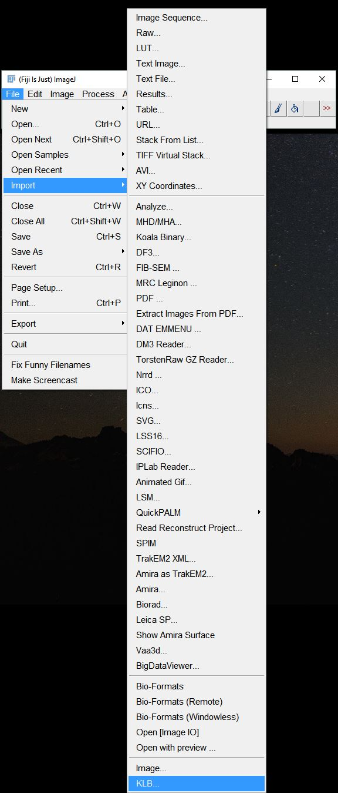
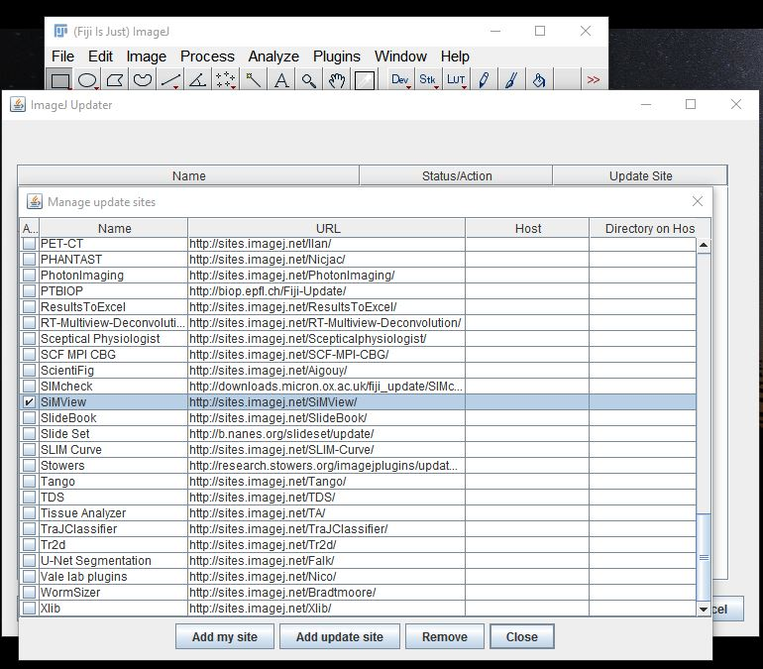
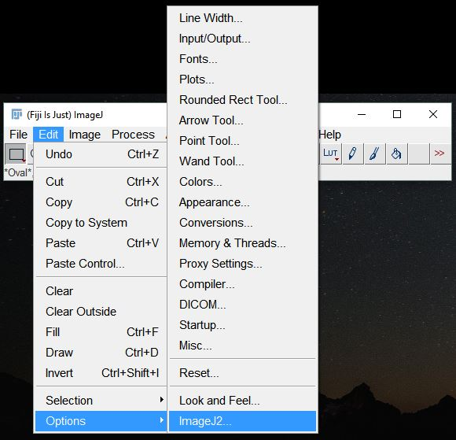
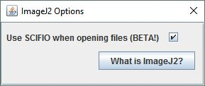
Image compression
.KLB IMAGES
  Viewable with Fiji

Slide 6
Fusion, drift correction and normalization
MATLAB scripts
Fusion of up to 4 orthogonal views
  No need for beads or other blob-like features
Image correlation to compute frame-to-frame fluctuations
Estimation of image geometric center to correct long-term drift
Intensity normalization

Slide 7
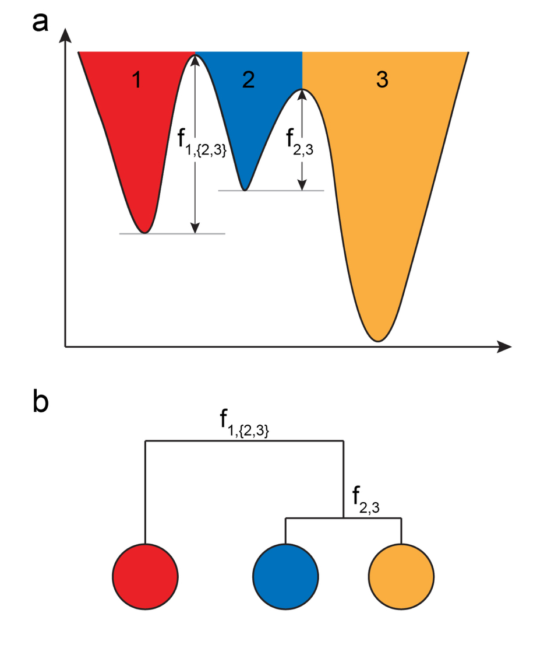
TGMM - segmentation
Segmentation using watershed persistence-based agglomeration to create supervoxels
Merging of regions obtained from watershed method
Critical value: 𝜏
Amat et al. 2014, Nature Methods

Slide 8
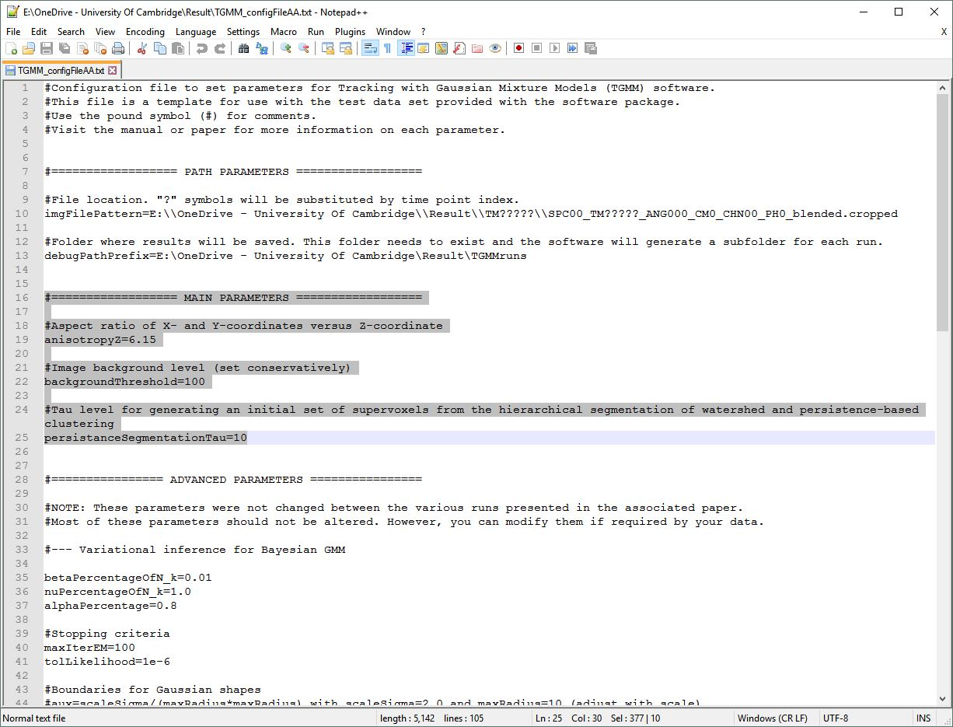
TGMM - segmentation
Precompiled binaries for windows (processstack.exe)
Use of CUDA-enabled GPU
Single t-point or time-series
  Visualization of segmentation results
A configuration file to define various parameters

Slide 9
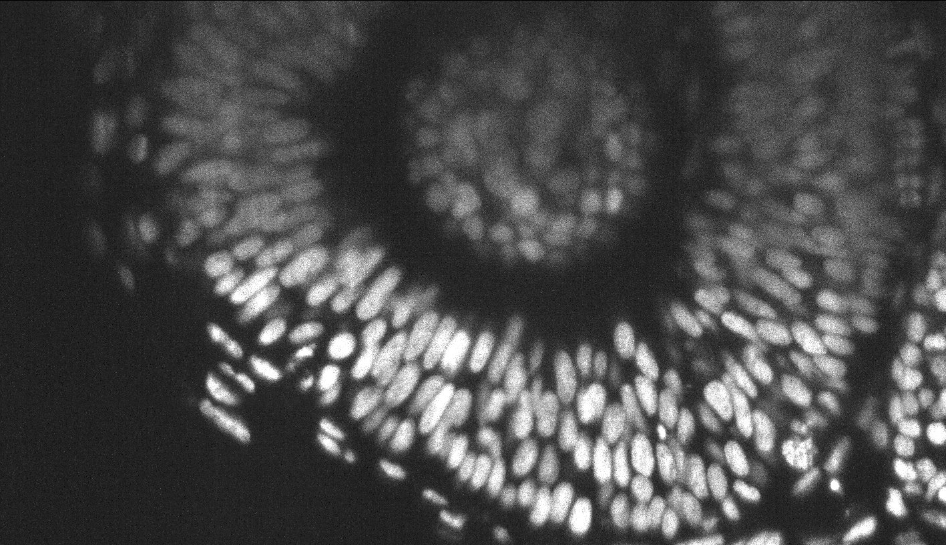
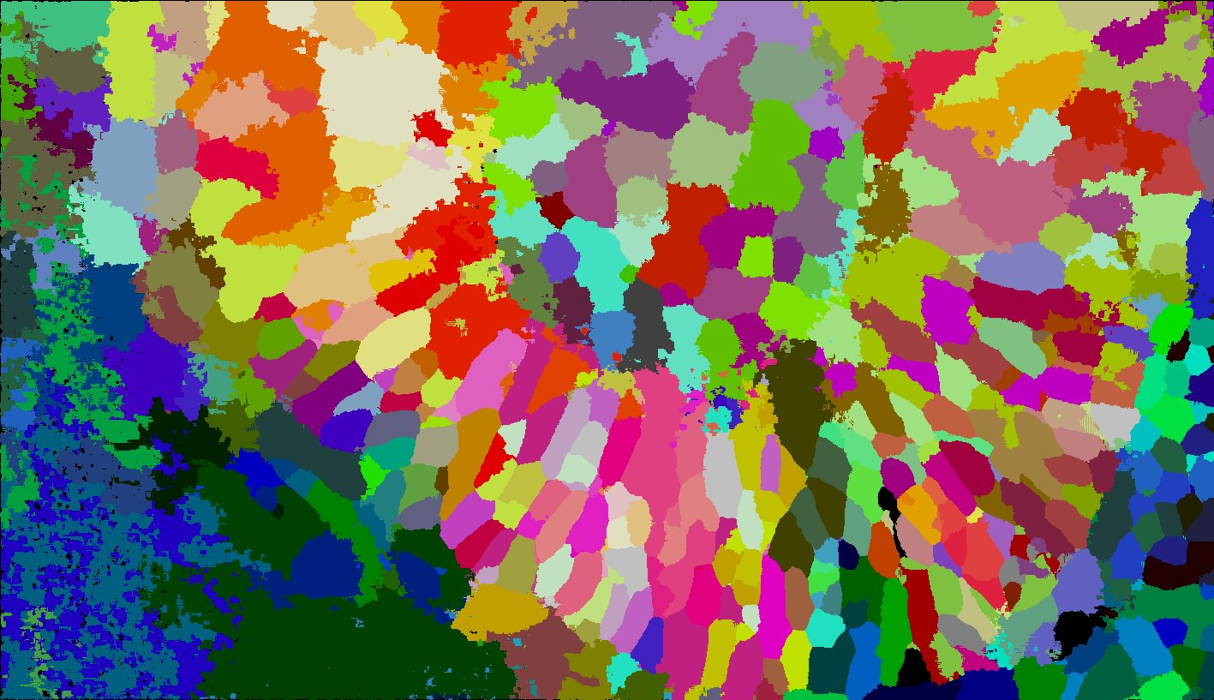
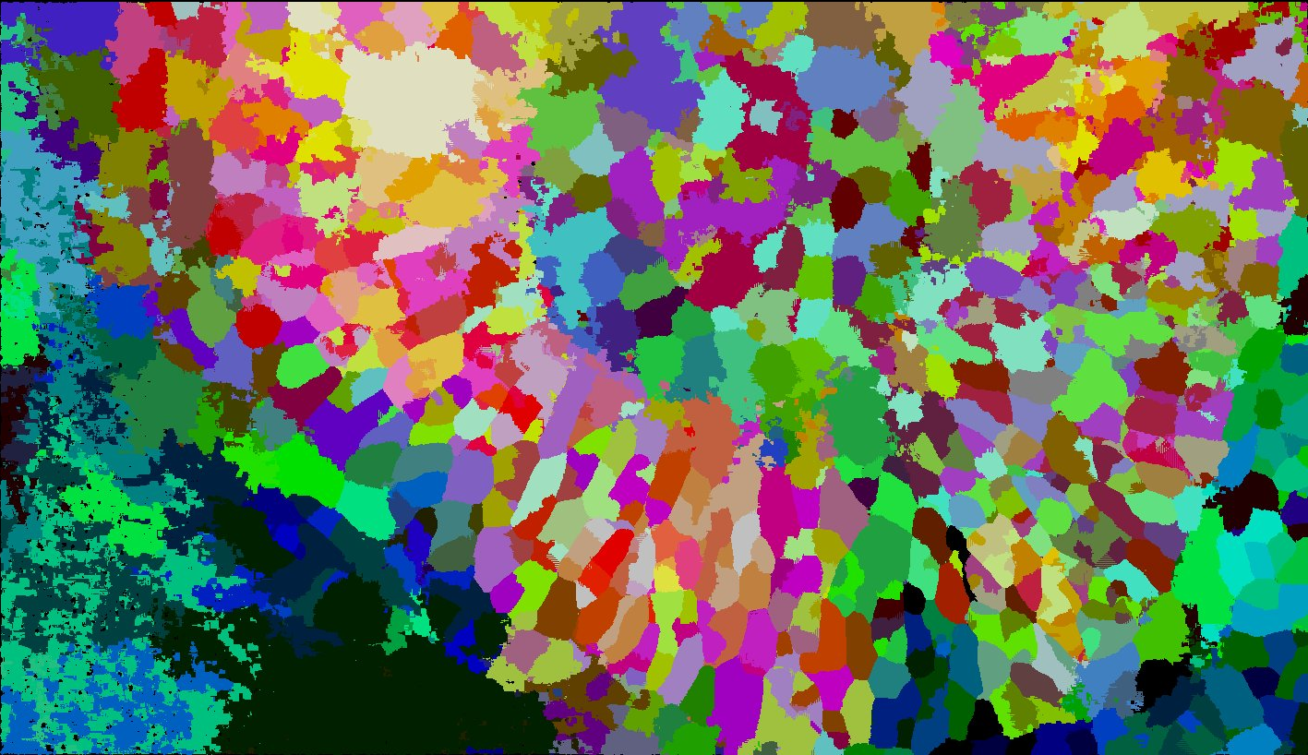
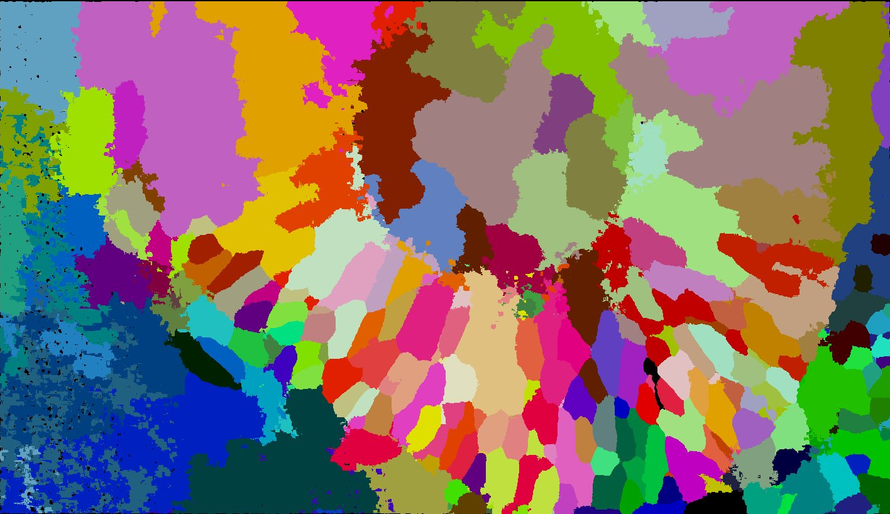
TGMM - segmentation
𝜏 = 5
𝜏 = 2
𝜏 = 20

Slide 10
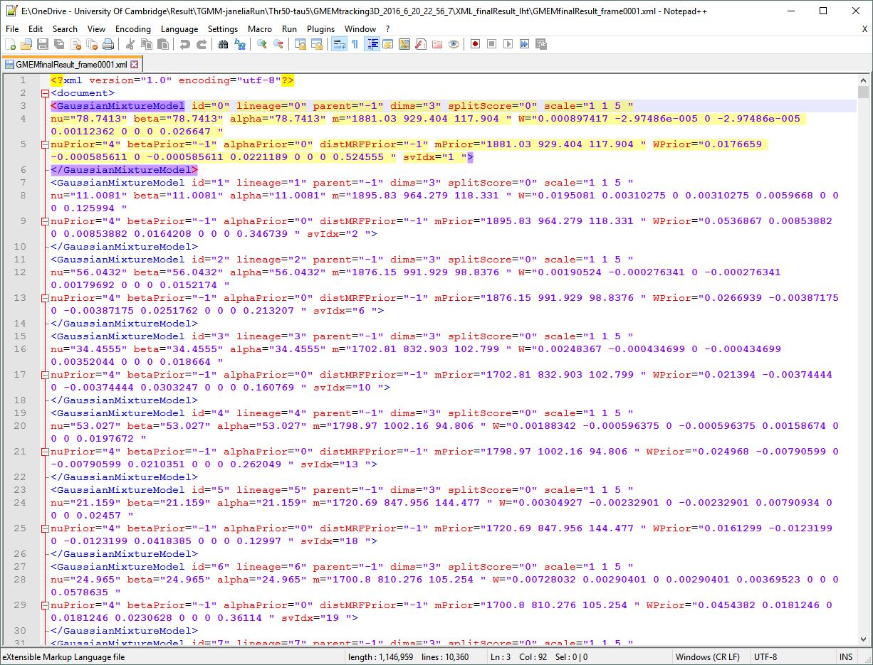
TGMM - tracking
Precompiled binaries for windows (TGMM.exe)
Must use CUDA-enabled GPU
High usage of RAM
Same configuration file as before
Creates xml files containing tracking information for each time point

Slide 11
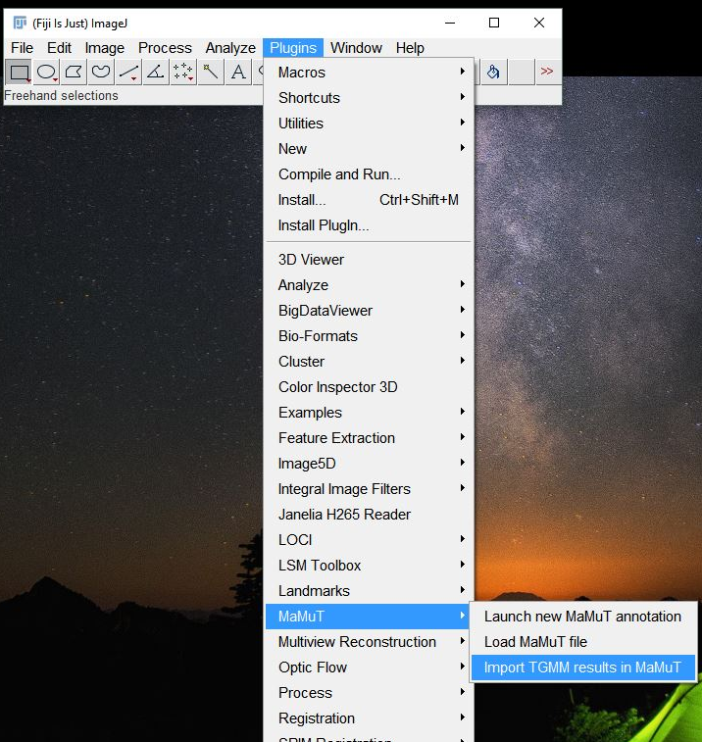
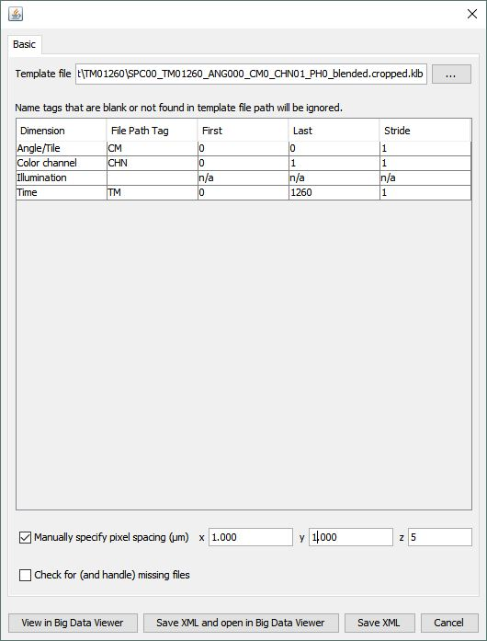
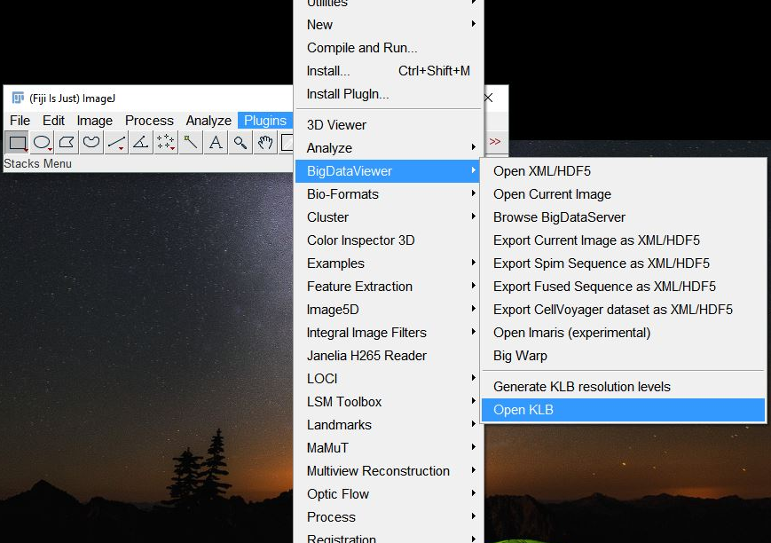
Visualization and curation of tracks
MaMuT plugin of Fiji
BigDataViewer import of image data

Slide 12
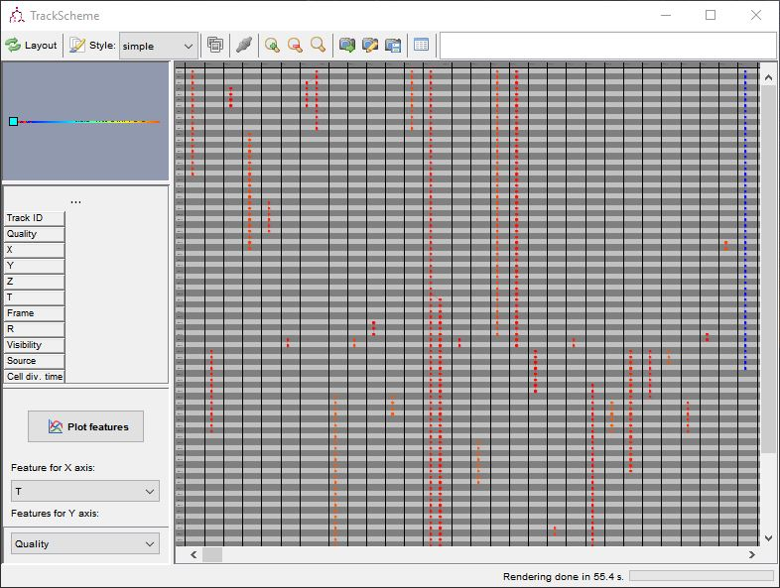
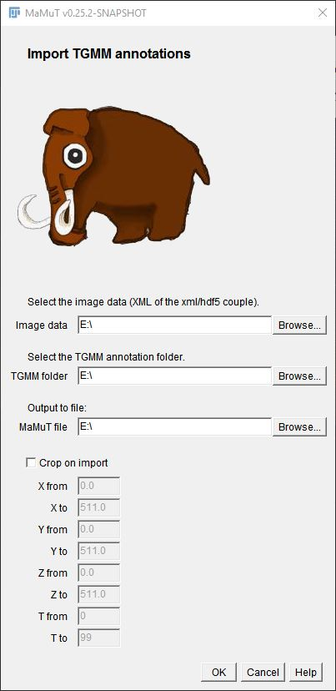
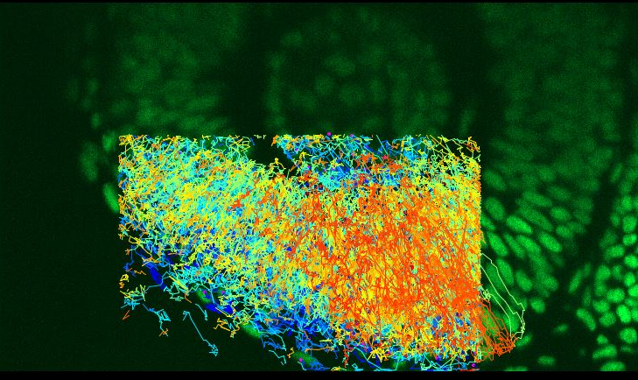
Visualization and curation of tracks
Can crop the regions for which tracks are displayed
  MaMuT crashes from too many data points
  Processing tracks and saving can take a long time
Tracks from MaMuT are saved in xml files

Slide 13
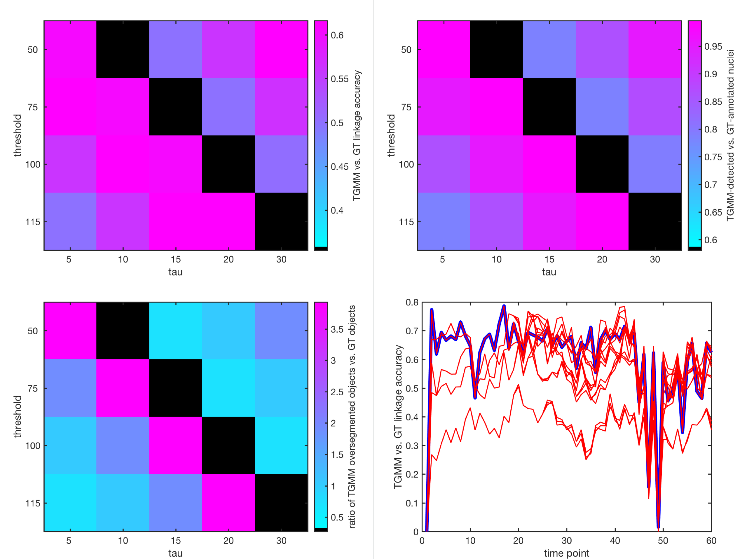
Quality control
Comparison of TGMM generated tracks with manually produced Ground Truth (GT)
  140 tracks over 2 hours

Slide 14
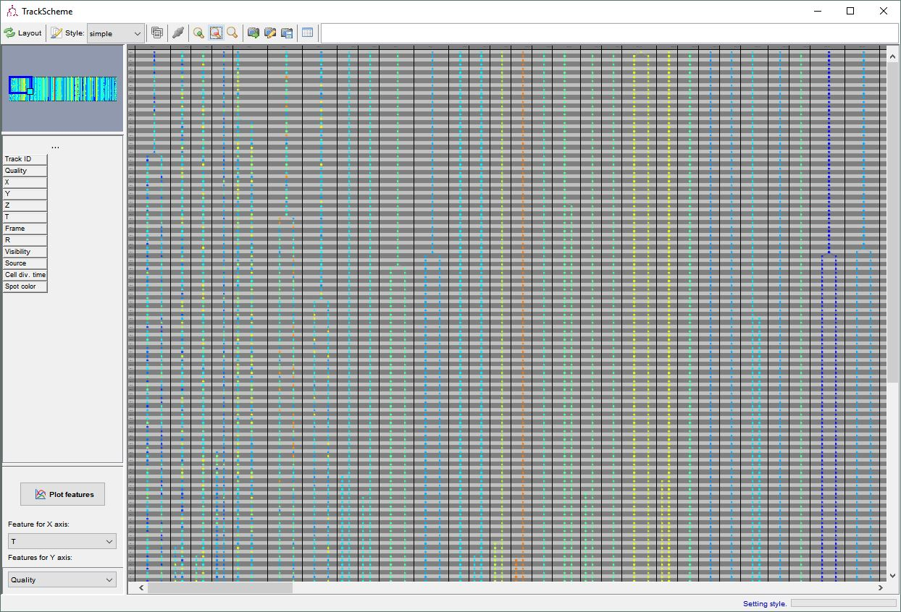
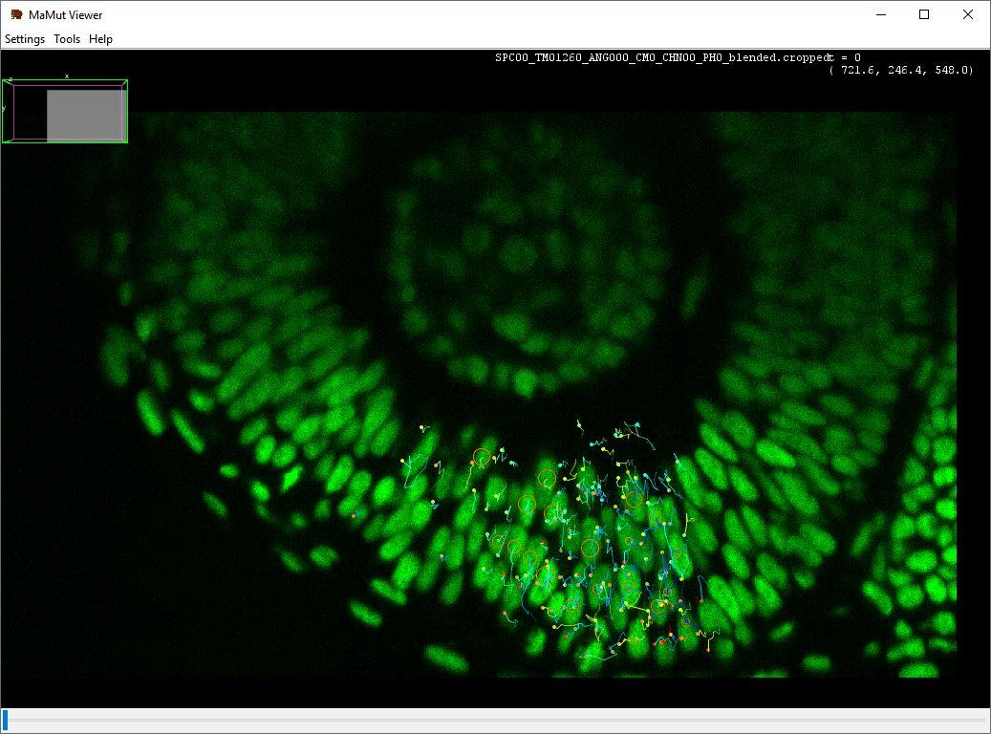
Curated tracks
Curation is ~3-4 times faster than manual tracking
Track information is stored in easily manipulable xml files
  matlab or other programs for downstream analysis

Slide 15
Improvements
Choice of GPU to use with TGMM.exe
  Can track multiple movies at the same time
  Requires multiple CUDA-enabled GPUs and very high RAM
Trainable classifier for cell divisions
  GUI based in MATLAB

Slide 16
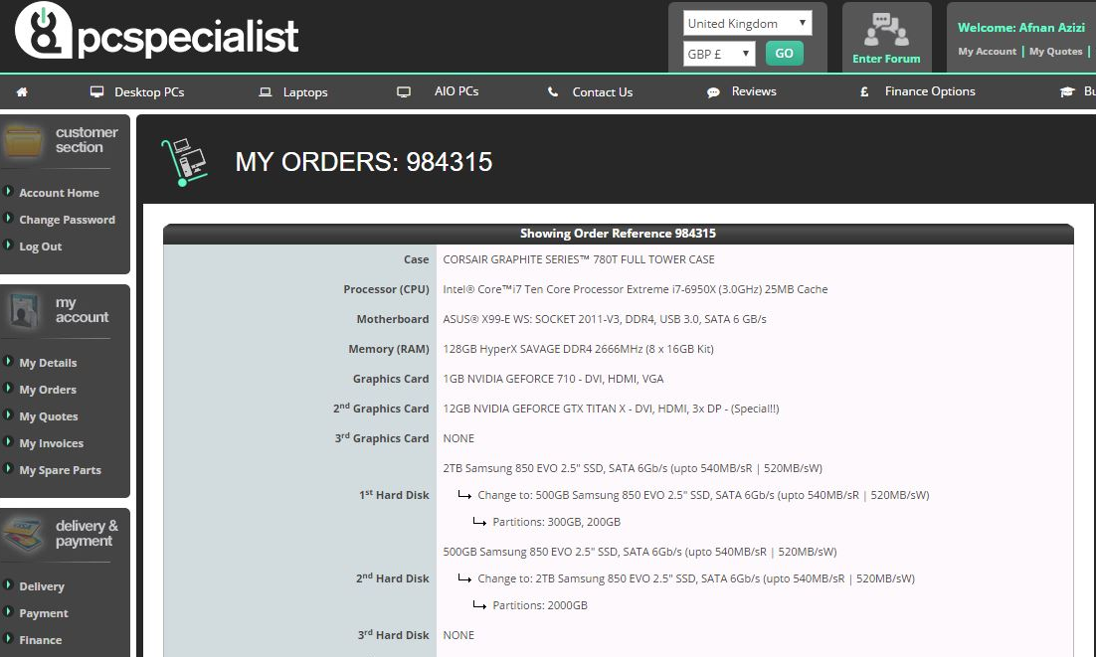
Hardware requirements
Multicore CPU (the more cores the better)
CUDA-enabled GPU (the more cores the better)
High amount of RAM
Solid-state drive for faster read and write
3072 CUDA cores

Slide 17
Thank you
Questions?

Slide 18
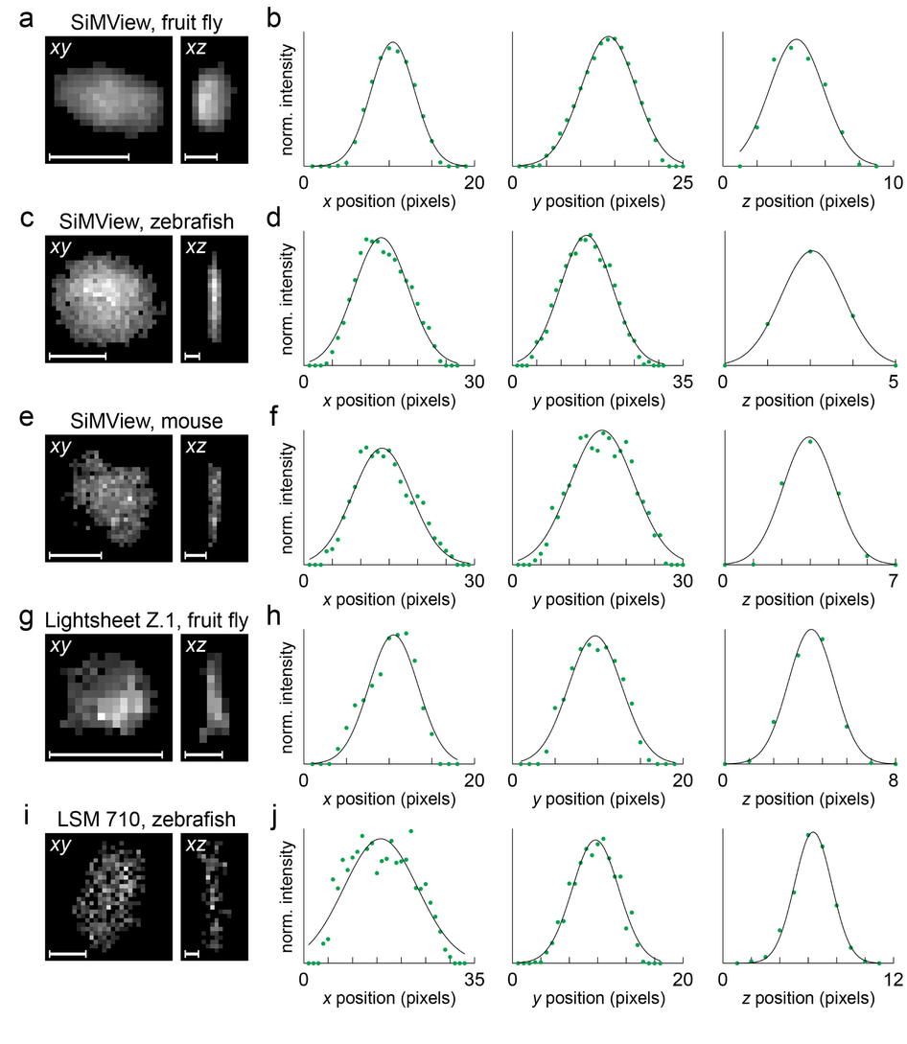

Slide 19
